Slide 1




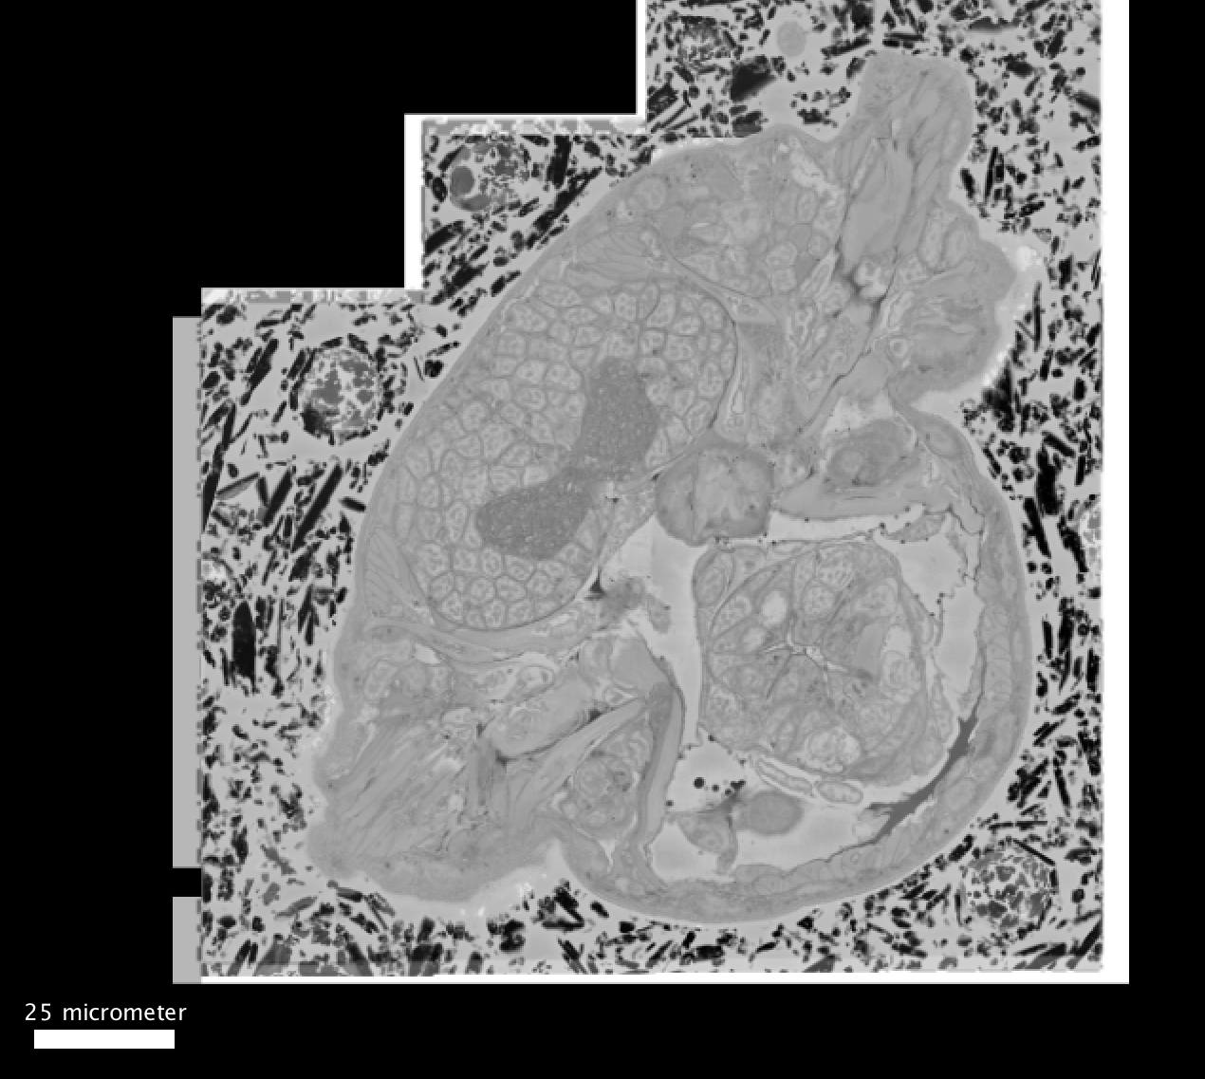
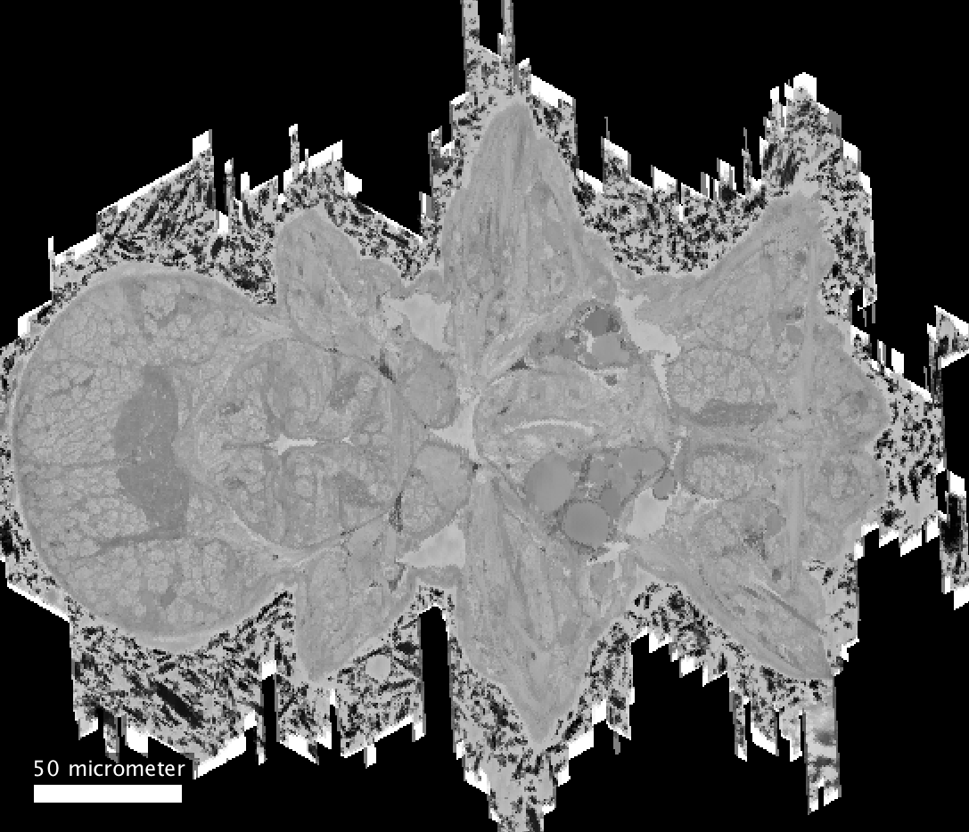
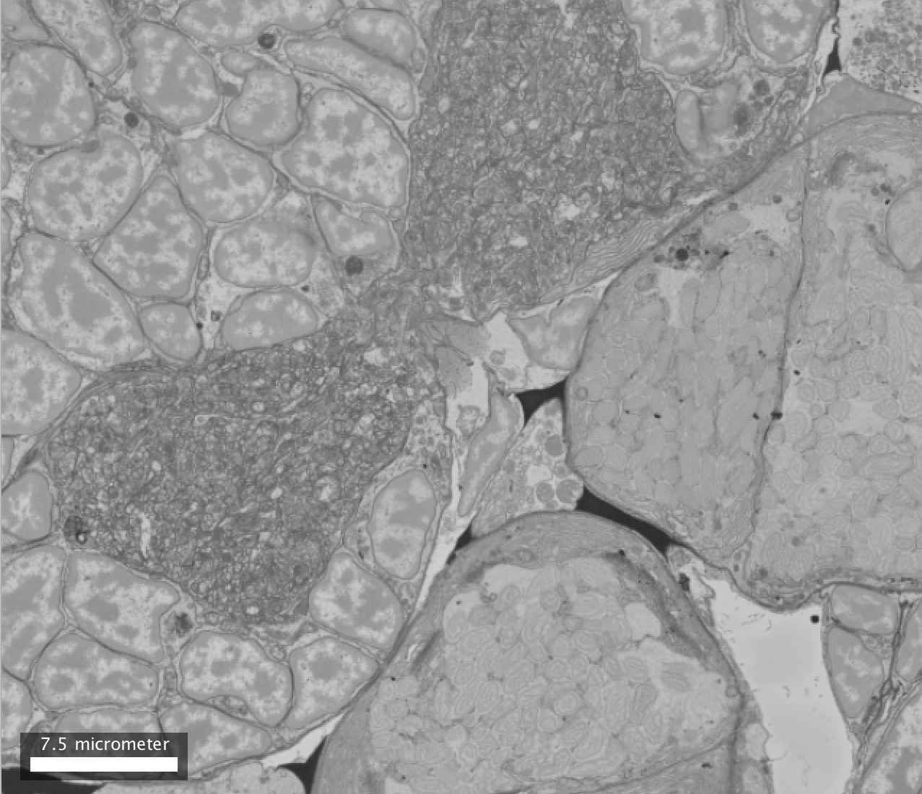

Slide 3
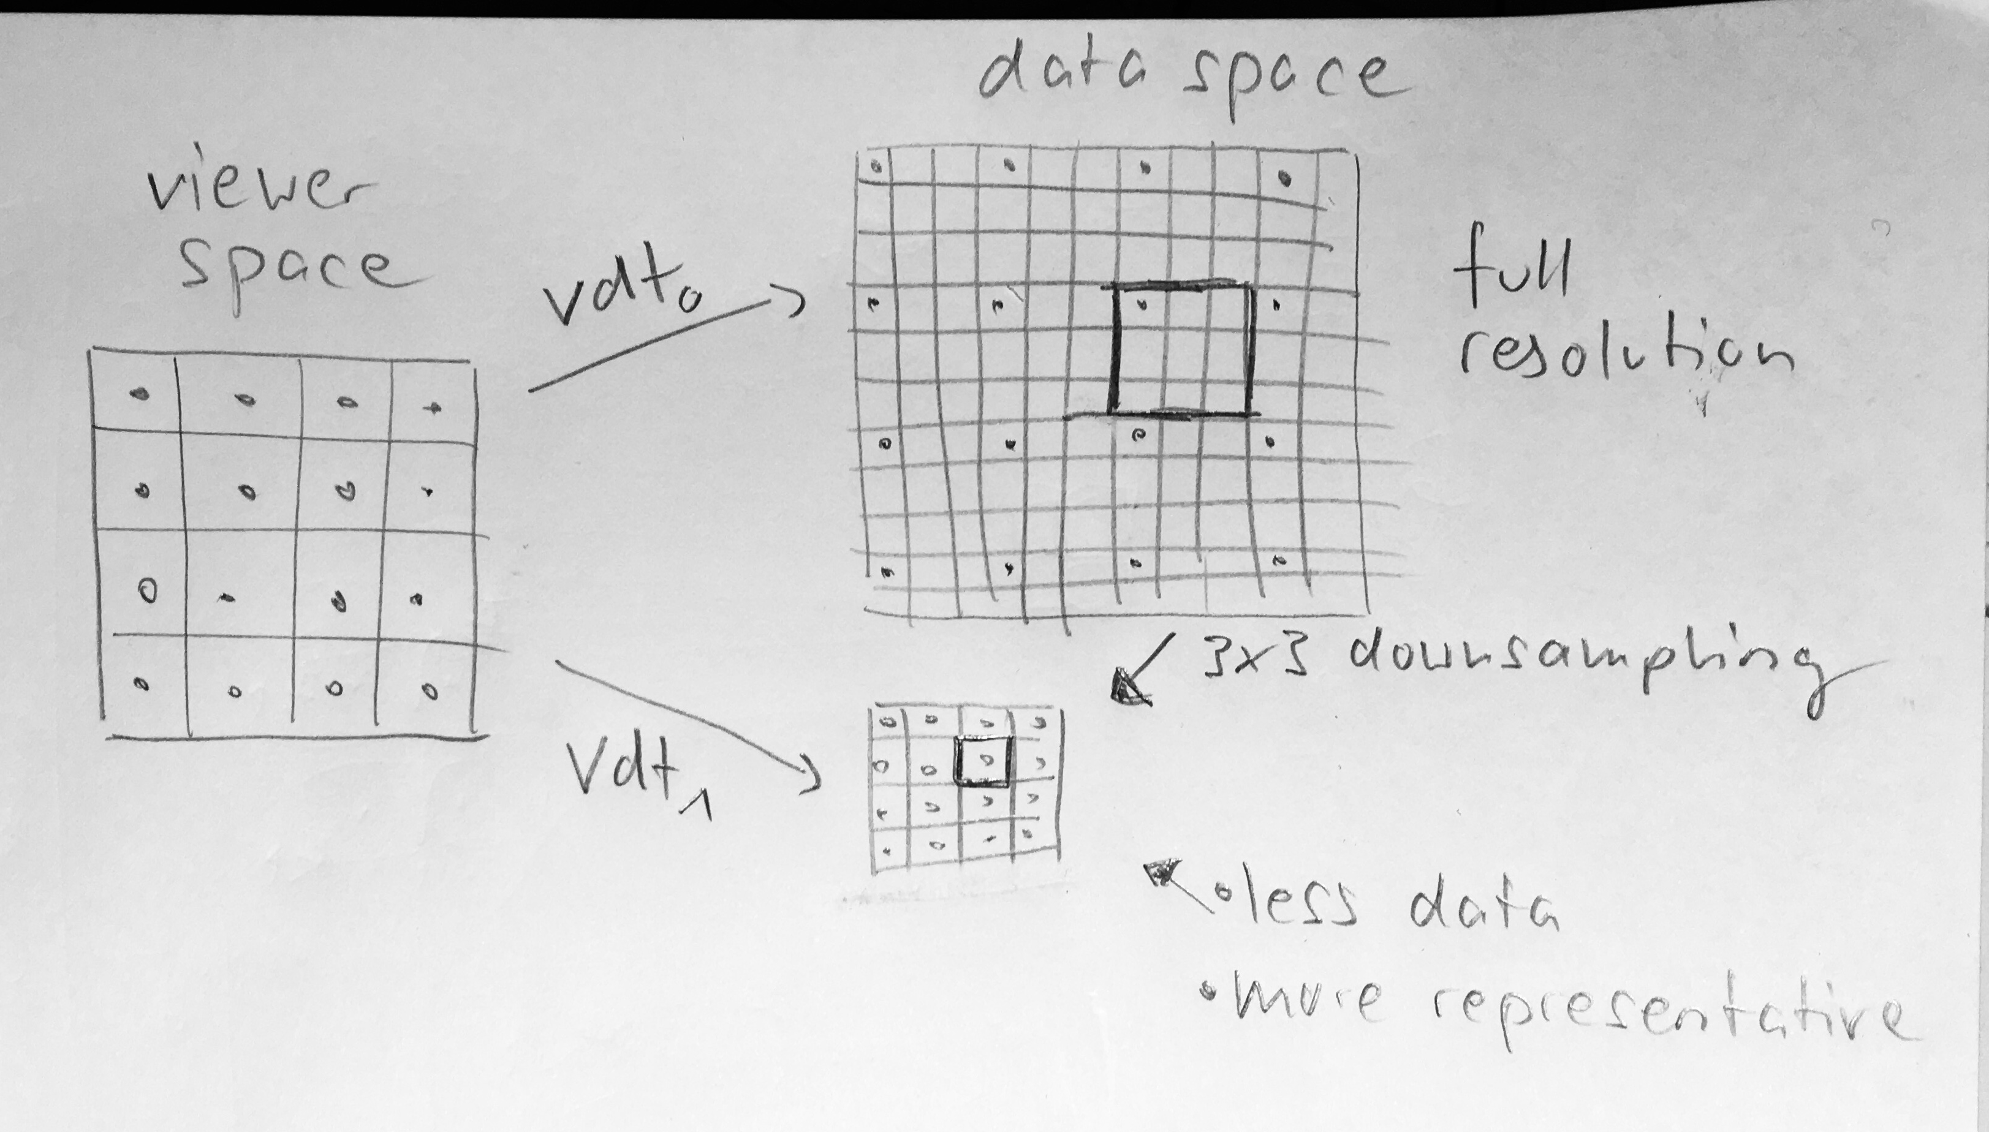
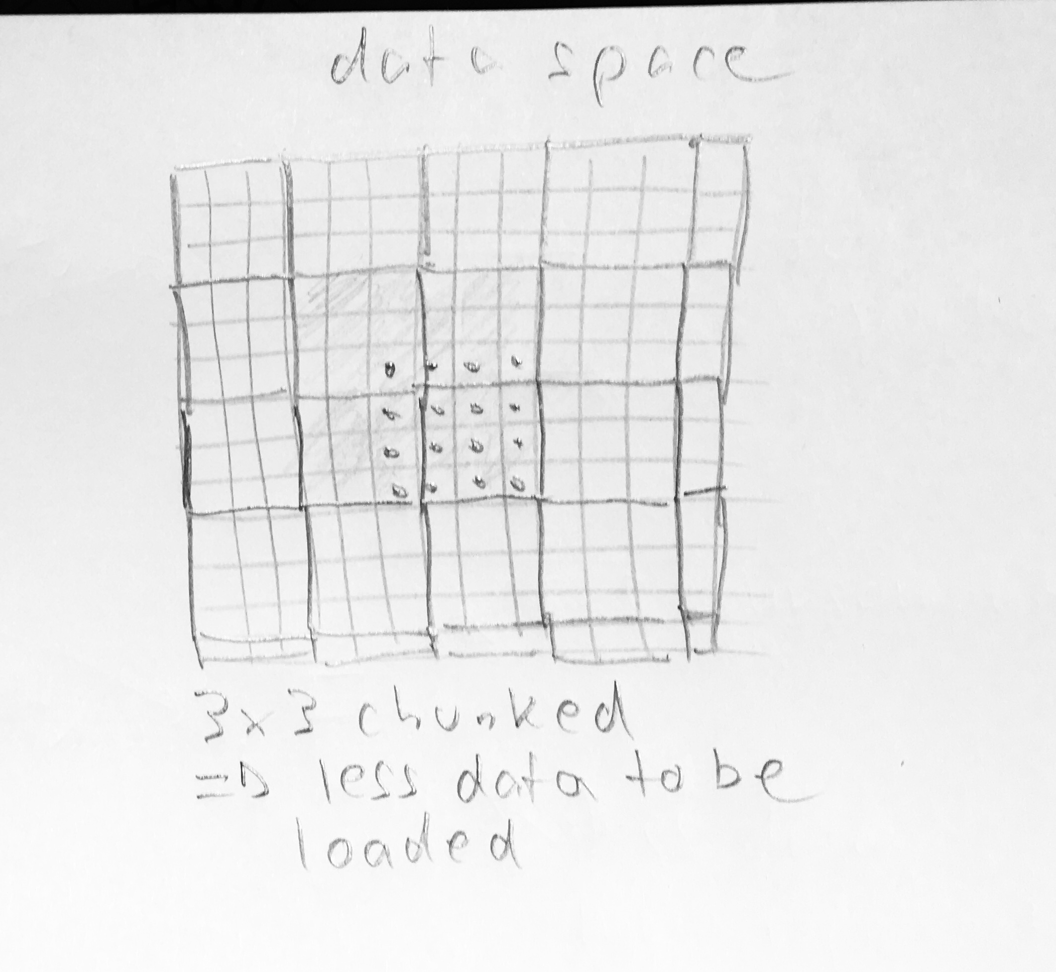
zoom in

Slide 4
Metadata
Data resolution 1
Data resolution 2
1010101…10000000000…100000000010001010…000101000000201000…10010000010001010…10000010010001010…1000001
Chunk width
…
Image dimensions (r)
Chunk dimensions (r)
Chunk width
Chunk height
2 x 2
Downsampling
Chunk height

